Slide 1
Infrastructure as Code
Shikha Jha
Techgrounds-Cohort 6
Learning Coaches- Coen Meulenkamp
Mandy Tentij

Slide 2
Agenda
Architectuur
Code on VS Code & Deployment on Management Console
Sales-pitch
Learnings
Greatest Challenge

Slide 3
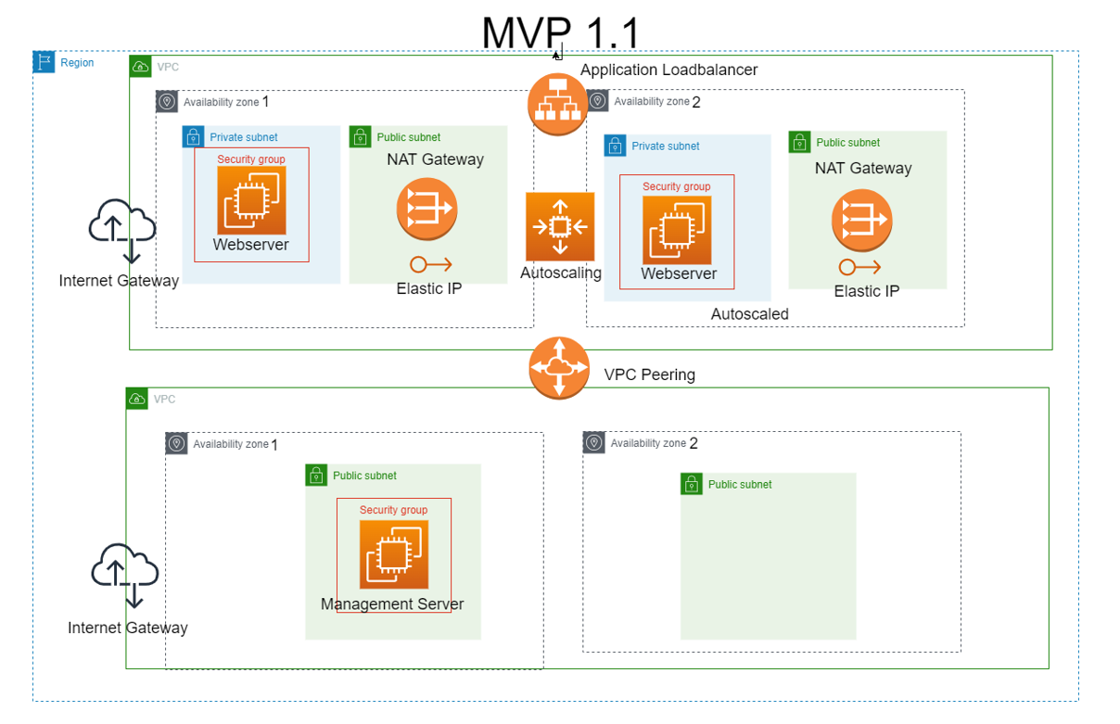
A
R
C
H
I
T
E
C
T
U
R
E

Slide 4
Sales-pitch
Shorter codes with function
Use of Default feature of CDK to save efforts.

Slide 5
Learnings
Hard-Skills
Python
CDK
AWS Services
Github
JEERA
LINUX
VS Code
Markdown language
Management
Diagram.io tool
Life-Skills
Learning is not talent but an attitude and perseverance pays.

Slide 6
Greatest Challenge surmounted
Built the trust that it is not inherent talent which takes one to excel but consistent efforts.

Slide 7

And the journey continues……….

